Slide 1
Senior exit interview
By: Elijiah Tirado

Slide 2
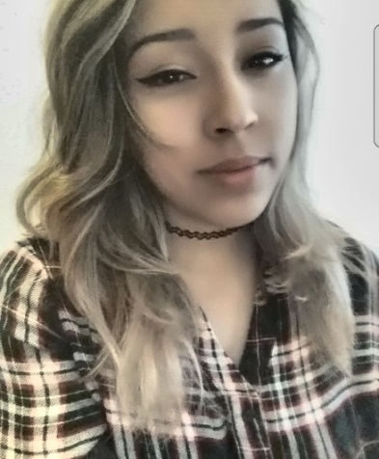
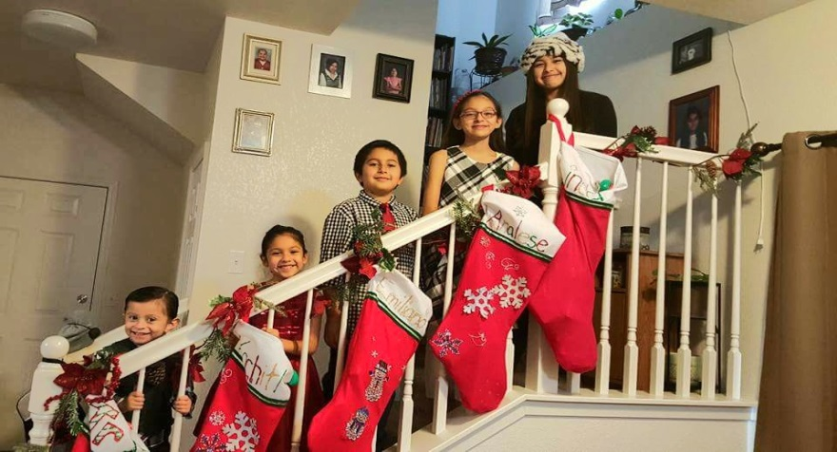
About me
Family of 9
7 siblings
4 sisters and 3 brothers
Second oldest followed by my sister Linda, then Analese, then my little brother Emiliano, then Xochitl, then Gerard Jr.
Expecting another sibling soon
Enjoy cooking and manual labor

Slide 3
High school life
Challenging
Meeting deadlines
Added to my life goal
PBS allowed me to work at my own pace

Slide 4
Job shadow
Gerard Garcia
Tulare Adult School for welding
Thought about welding as a life goal
He did teach me a lot while I was there to and it helps me now

Slide 5
pathway
Ag Mechanics
It is something that i had been leaning toward since I first got into high school but now I see it as more of a hobby
I chose it as a pathway because I knew it would help me in the future plus it’s just further knowledge to have

Slide 6
Leaving lhs
Experiences/Memories
Mechanics
Workshop
Studies
Classes enrolled in
Friendship
Jacob
taught me a little about life, look forward to adulthood and its challenges
going to get into Tulare Adult School directly following graduating

Slide 7
After high school
Jobs
Chef
College/vocational school
Tulare adult school
Pc
Degree in Culinary Arts
Traveling as a chef

Slide 8
Thank you!!

